Slide 1
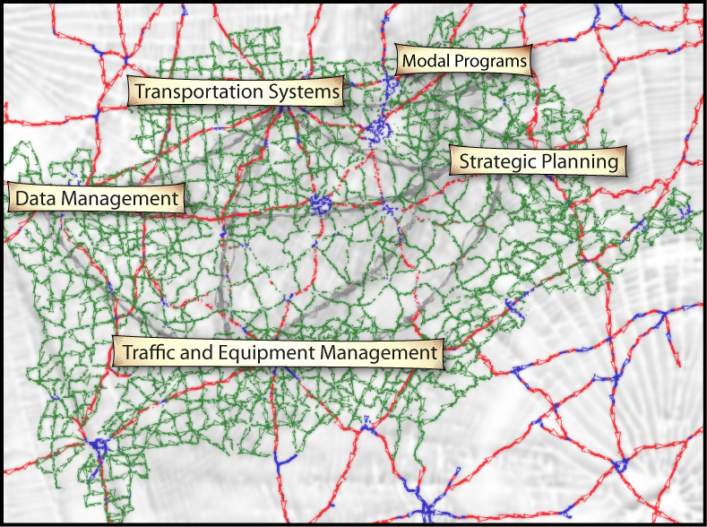
Planning – 101
– September 9, 2015

Slide 2
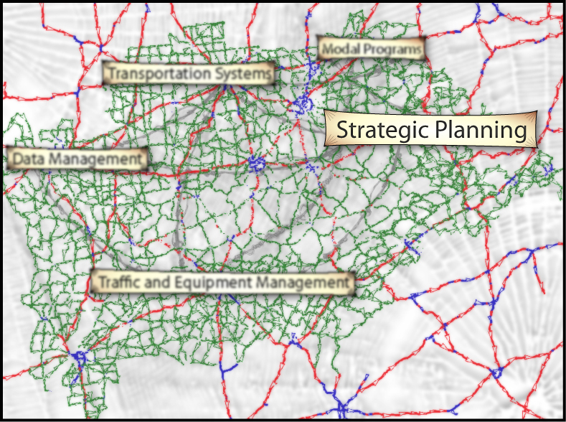
Strategic Planning Branch

Slide 3
How an “Idea” Becomes a Project

Slide 4
What types of studies are done?
DNA (Data Needs Analysis) Pre-Design Scoping Studies - aka First Look Studies
Programming Studies
SUA (Small Urban Area) Studies
Interchange Justification Studies
Special Studies

Slide 5
Project Identification
Coordinate with our Partners
ADDs - Area Development Districts
MPOs - Metropolitan Planning Organizations
John Q. Public

Slide 6
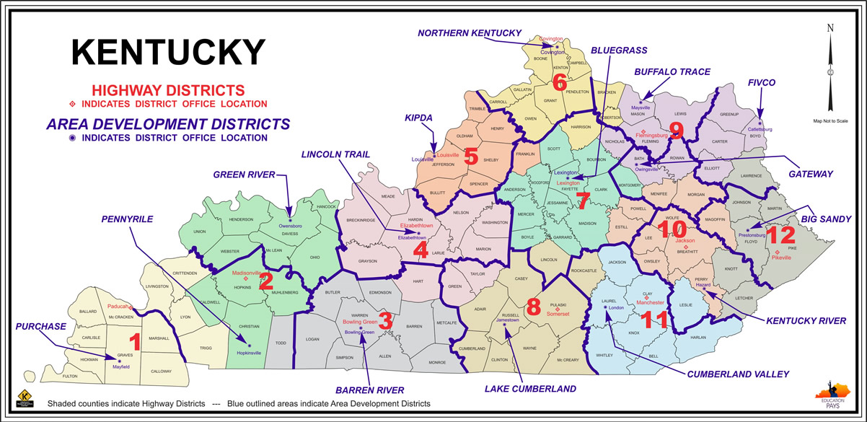
Area Development Districts (ADDs)

Slide 7
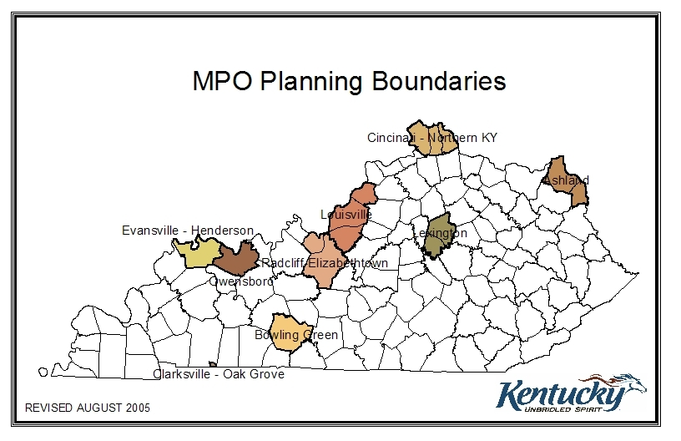
Metropolitan Planning Organizations (MPOs)

Slide 8
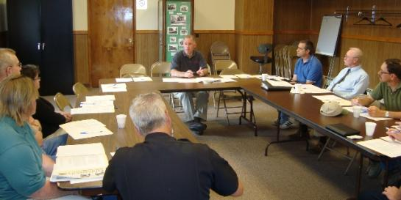
Transportation Committees
ADDs and MPOs work through Transportation Committees to identify their projects
Committee Representation
  Transportation Stakeholders
  Local Officials

Slide 9
So how is a Project Identified?
PIF - Project Identification Forms
  Submitted by ADDs & MPOs

Slide 10
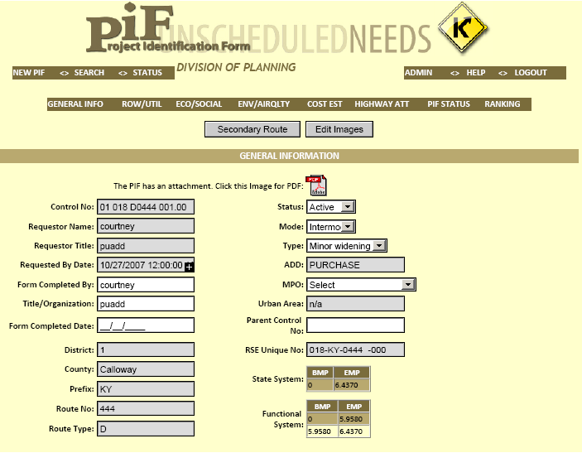
Project Identification Form

Slide 11
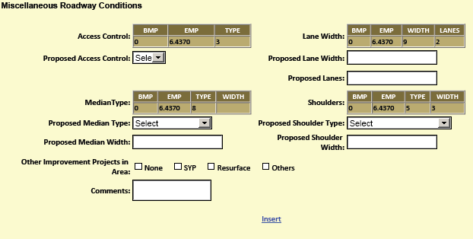
Project Identification Form

Slide 12
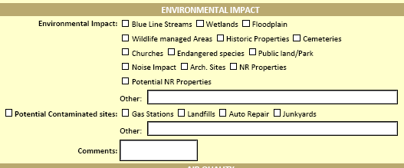
Project Identification Form

Slide 13
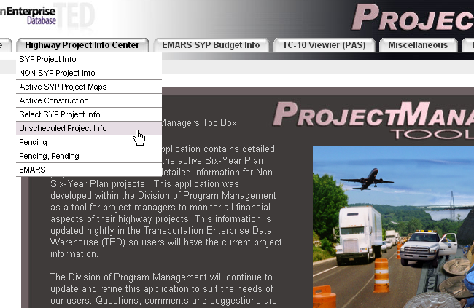
Unscheduled Project Information

Slide 14
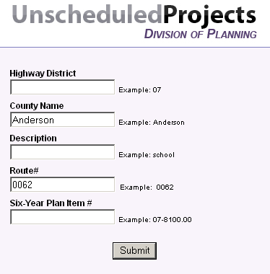
Unscheduled Project Information

Slide 15
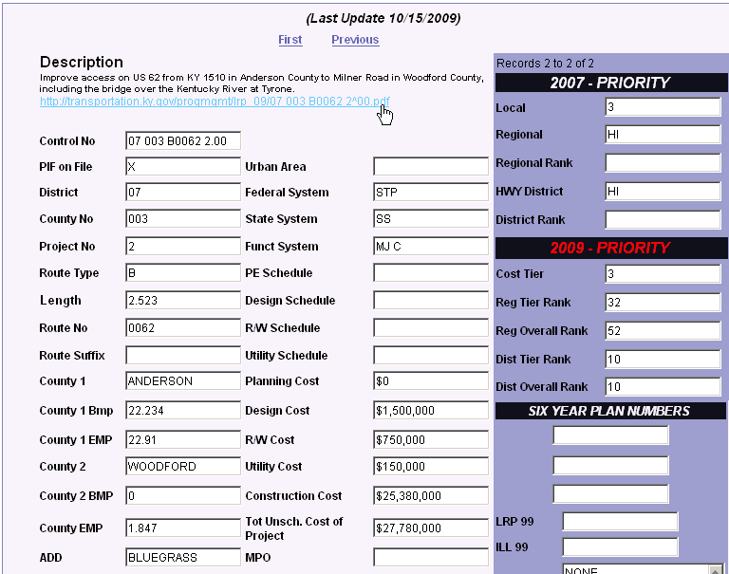
Unscheduled Project Information

Slide 16
More on PIFs
PIFs are entered in the Unscheduled Needs List Database (UNL)
Projects are Prioritized
First established in 1988
>2400 Current Projects
$70 billion
8000 miles of roadway

Slide 17
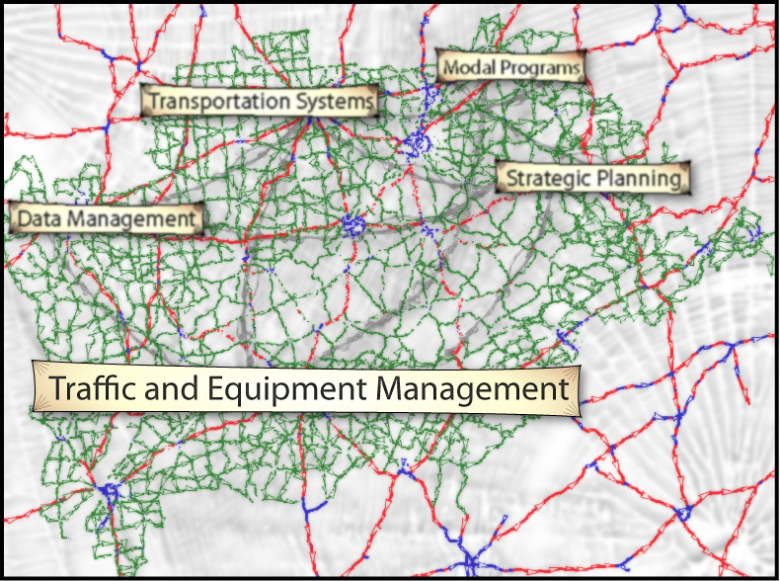
Traffic and Equipment Management Branch

Slide 18

























Traffic and Equipment Management Branch
“We’re Really the Only Ones Who Count”
We collect various types of traffic data:
  Volume
  Classification of 13 vehicle types
  Speed data by direction
  Weight (Weigh-in-Motion)
23
22
21
20
19
18
17
16
15
14
13
12
11
10
9
8
7
6
5
4
3
2
1
TEMAC 01

Slide 19
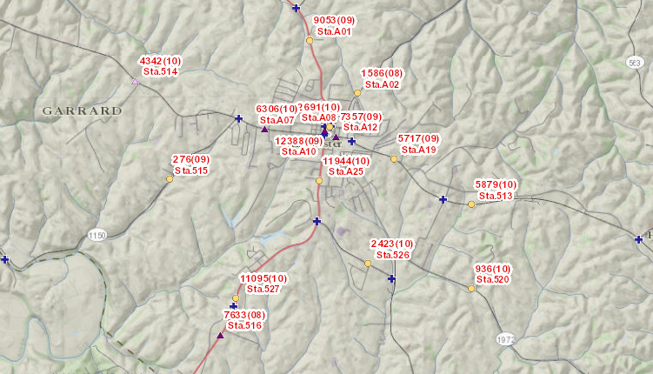
Statewide Station Locations
Segments on all state-maintained routes + local rural minor collector and above
TEMAC 02
Notes:
Traffic count definition, 1/3 to ½ the distance towards most traffic is flowing. We are looking for an average number of vehicles.
Traffic stations break at county lines, since there are no major traffic generators on this route the same station represents traffic in both counties. We call this an adjacent count station. Only one of these have counts performed.

Slide 20

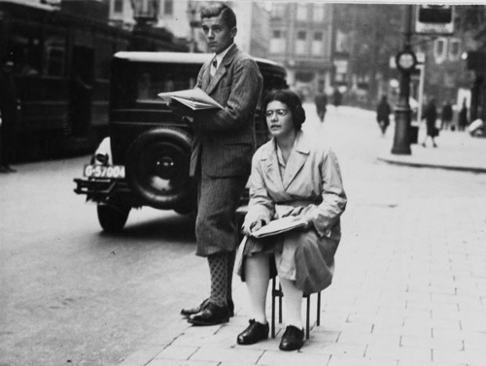
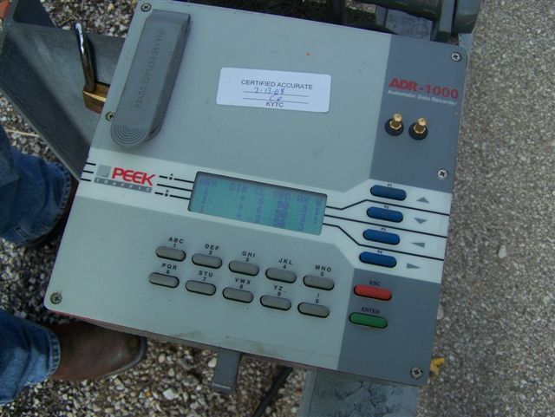
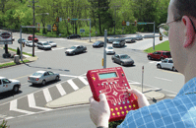
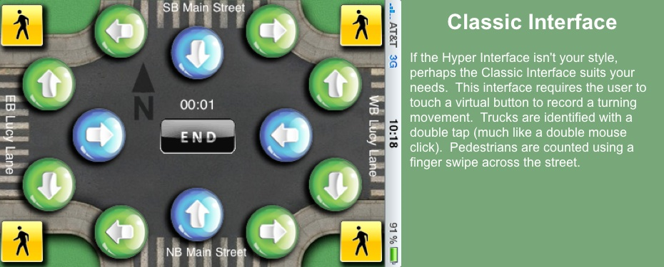
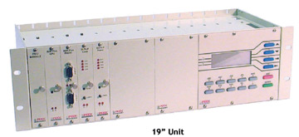
Data Recorders
Manual
Automatic
TEMAC 03
Notes:
This is showing the direction, class, number axles speed.

Slide 21
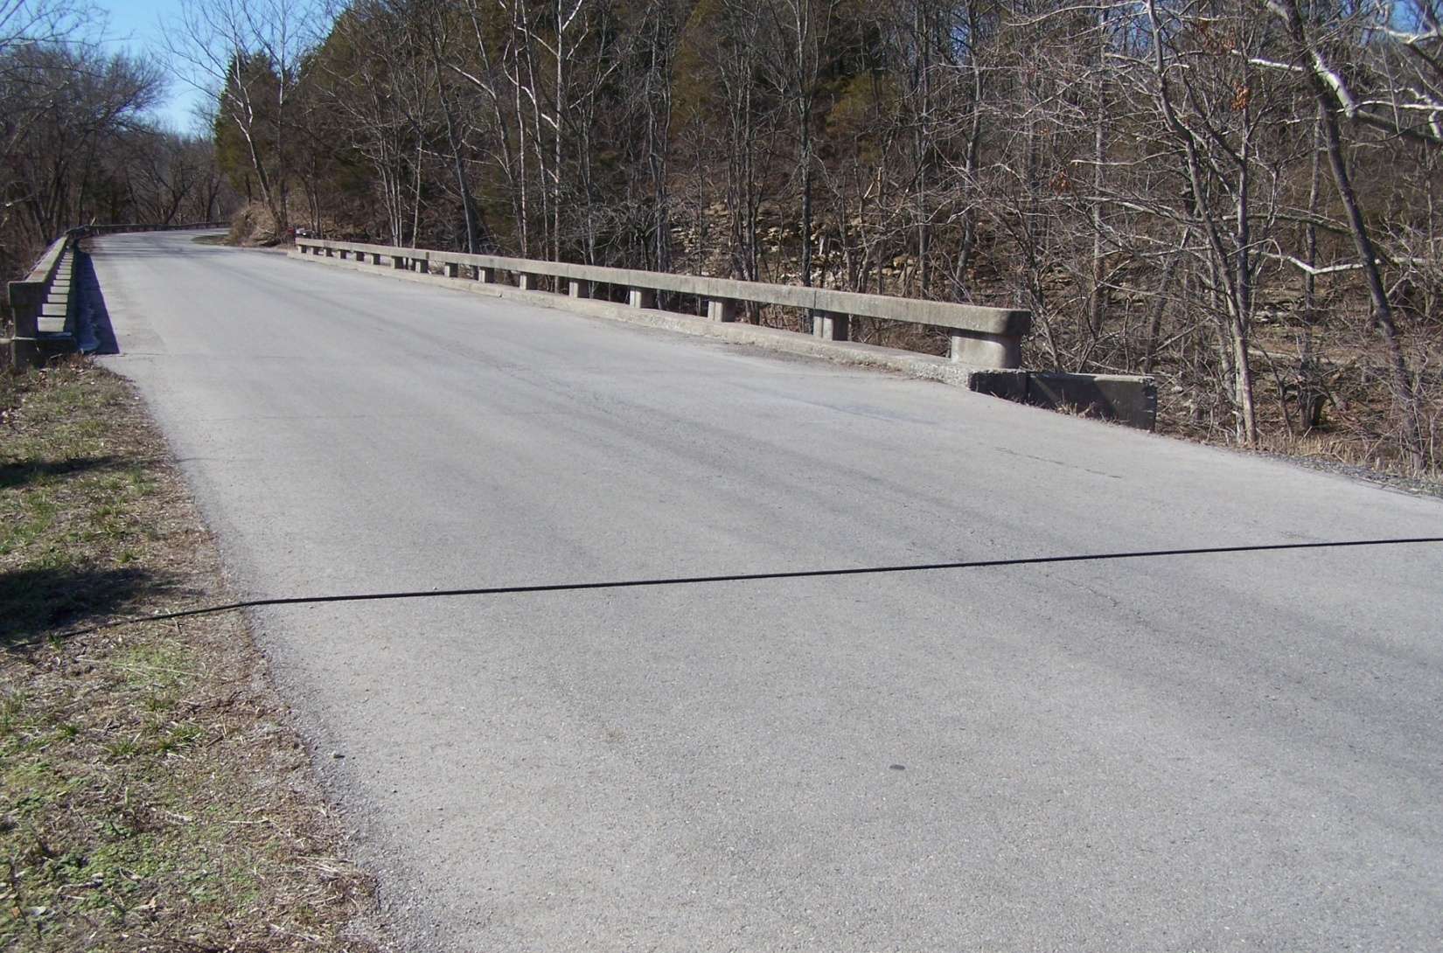
Portable Volume Count with a Single Road Tube
Short Duration Counts – 14,500+ Statewide on a three year cycle
TEMAC 04
Notes:
(display the counter), Pneumatic road tubes, Plugs into the Automatic Data Recorder 3 year cycle

Slide 22
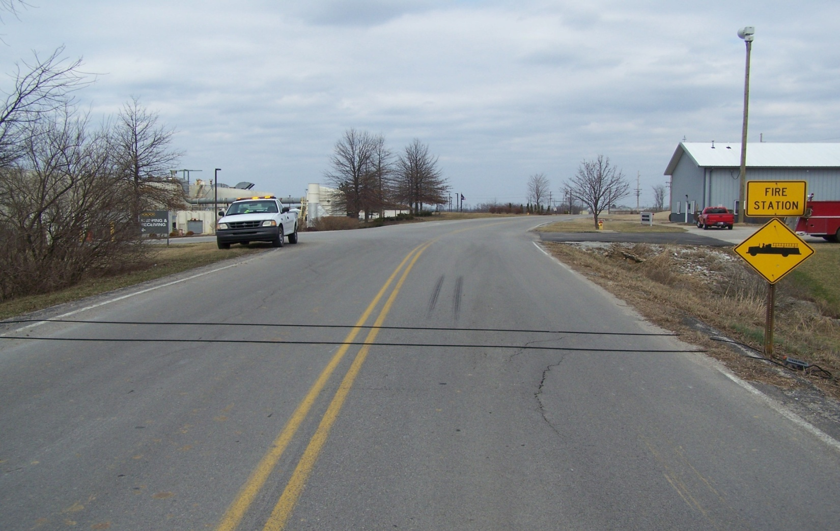
Portable Classification Count with Road Tubes
~20% of all short counts; can also provide Volume and Speed by Direction
TEMAC 05
Notes:
2 pneumatic road tubes, set a different spacing's based on speed and volume of traffic, this type of count requires free flowing traffic, (display the ADR)

Slide 23
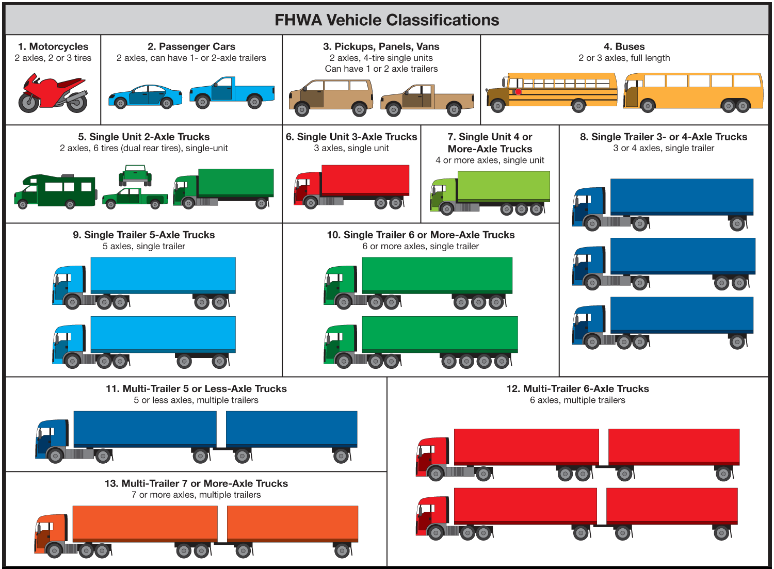
FHWA Vehicle Classifications
TEMAC 06
Notes:
Class 4 also includes school buses
Class 5 also includes flat bed and dually pickups
Class 9 is your typical eighteen wheeler up to 53’
Class 11 is similar to the UPS and FedEx trucks you see on the hightway

Slide 24
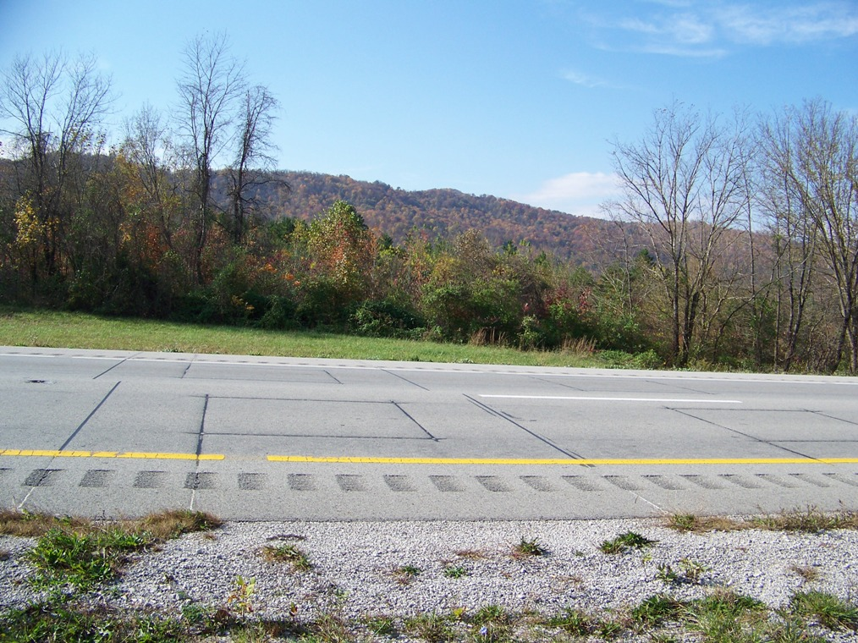
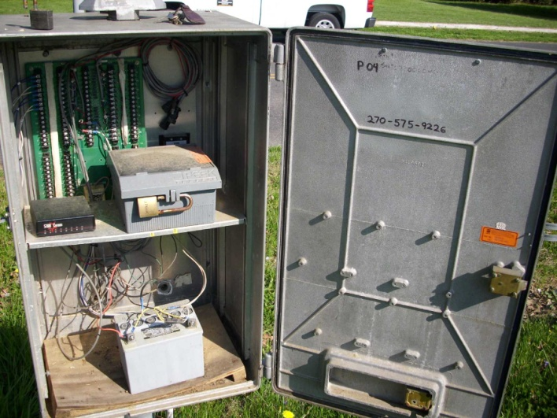
Count Stations with In-pavement sensors
~500 Statewide semi-permanent; ~80 ATRs; ~25 WIM
TEMAC 07
Notes:
As Steve had mentioned before this is a brass piezo, each location is gps’d and is in the process of being placed in IMS and on PIFS, this particular site can cost 5-30K. If these loops are within your project they must be replaced, please notify us and we can give you a bid packet with specs so that they can be replaced.

Slide 25
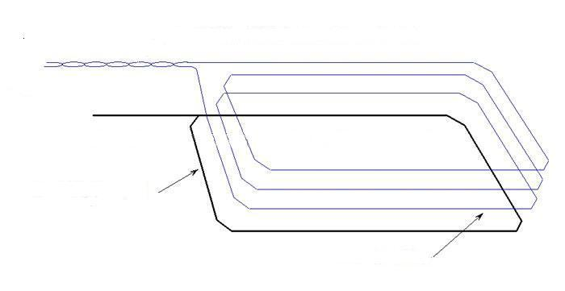
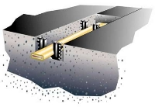
Induction Loop and Piezoelectric Sensors
Saw Slot
Loop Wires
Piezoelectric Sensor (Piezo)
TEMAC 08

Slide 26

Data Processing
We process the collected data and calculate :
  Adjustment Factors
    Day of week and seasonal factors
    Axle factors
    Design hour factors
  Annual Average Daily Traffic (AADT)
  Daily Vehicle Miles Traveled (DVMT)
TEMAC 09
Notes:
This box, these sites can cost from 50-75K, these are strategically located across the state and count different functionally classed roadways. These ATR’s have 110v, phone lines and some solar powered. This data is submitted to FHWA for reporting and identifying travel trends.

Slide 27
Reporting and Data Usage
We provide :
  Data for other Planning Branches
  Reports for FHWA, KYTC, KTC, and various other agencies with an interest in transportation data
  Information for Public Consumption
  Data is used for such things as:
    Allocating Highway Costs
    Roadway and Bridge Design and Maintenance
    Analyses: Safety, Capacity, Timing, Speed, Noise
    Air Quality Assessment
    Helping businesses decide where to locate
TEMAC 10
Notes:
This box, these sites can cost from 50-75K, these are strategically located across the state and count different functionally classed roadways. These ATR’s have 110v, phone lines and some solar powered. This data is submitted to FHWA for reporting and identifying travel trends.

Slide 28
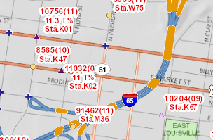
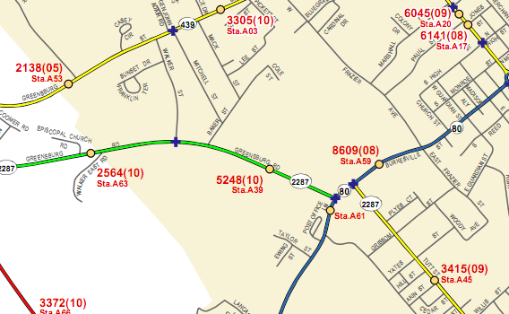
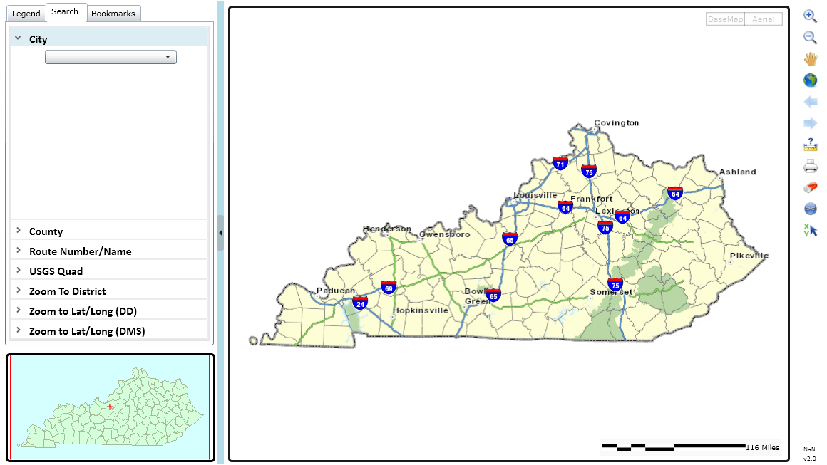
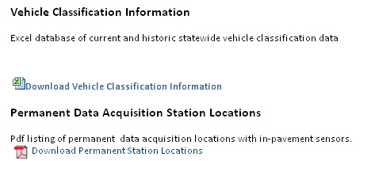
Readily Available Information
KYTC Division of Planning Website
Count Maps
(Counties and Incorporated Areas)
Traffic Count Interactive Map
TEMAC 11
Notes:
If you zoom in you can pick up details on that count station, 040 is the county, 753 is the station, 2007 is the count year, 9011 is the ADT. Once we have collected, processed the actual traffic count, validate the count we then forward this data to DATA Management.

Slide 29
Traffic Count Information
Resources and Contacts
  Website
  http://transportation.ky.gov/Planning/Pages/count-maps.aspx
  Humans
  melissap.brown@ky.gov – 502-782-5049
  jadie.tomlinson@ky.gov – 502-782-5087
TEMAC 12

Slide 30
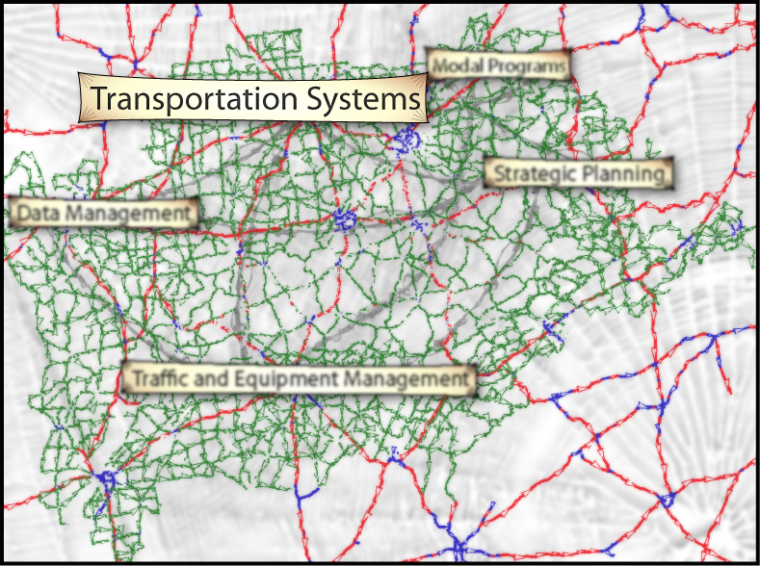
Transportation Systems Branch
Notes:
Transportation Systems Branch deals with highway projects from design through construction and even after they have been in place a long time.
We maintain the highway classifications used for design of new alignments, operations and maintenance and analysis of roadways for possible improvements.

Slide 31
Systems Branch Responsibilities
Coordinate, Process OO’s, Assign Roadway Systems, Update Maps
Coordinate State Road Project Roadway Information with the District Offices
Process Official Orders of the State Primary Roadway System
Update Other Highway Systems as needed (Coal haul, Truck Route, Forest Highway, etc.)
Update Maps as changes take place in the System
Produce the Official KY State Highway Map
Notes:
How will the road function within the overall network –
Get it down on paper and communicate so that Keith will know how to get the data for the new road correctly updated

Slide 32
Considerations for State Road Project Info
When Planning and Designing Project
What volume of traffic will the project carry?
What type of traffic will it carry?
Will it need to be maintained out of RS funds? MP?
Will it affect traffic on nearby roads – should their systems change?
Notes:
How will the road function within the overall network –
Get it down on paper and communicate so that Keith will know how to get the data for the new road correctly updated

Slide 33
Considerations for State Road Project Info
Minimize Mileage Added to State Maintenance
Determine who should maintain all bypassed state roadbeds (paving, mowing, snow & ice, drainage, traffic counts, etc.)
Negotiate with local government to accept what they should maintain (during Phase I)
Notes:
Transportation Systems is in responsible both for classification of roadways within the various systems, but also, especially within the current financial environment, to try to at the very least, hold down the total state-maintained road mileage, and, if possible, to reduce it.
To do that, we must analyze which government should logically be caring for roadbeds, whether they be the new alignment or bypassed segments, which we like to call Old Dogs – they are worn out and not good for much! How do these roads fit into the total road network? If they mainly provide access to homes or farms (remember the subdivision?) then they should logically be maintained by the local government. So, During Phase I design, try to negotiate with the local government to accept any parts of the project that they should maintain.

Slide 34
Bypassed Sections of Roads
Relevance to KYTC for Maintenance Purposes
Are these bypassed segments relevant to state traffic
If not, negotiate with local government to transfer
Notes:
This is another project on US27 in Garrard County which has been let for construction and should be open in the fall. Because we have the electronic design plans for this project, we can show both the new alignment and the Old Dogs. (Keith will discuss the data implications of being able to display both alignments on a single map.)
Notice the bypassed segments that are going to remain in place – we don’t want to add to District 7’s maintenance load – once the road is open, you have no leverage to get the locals to take care of it. If they won’t, maybe the design could be revised to be closer to the original alignment and not leave any Old Dogs

Slide 35
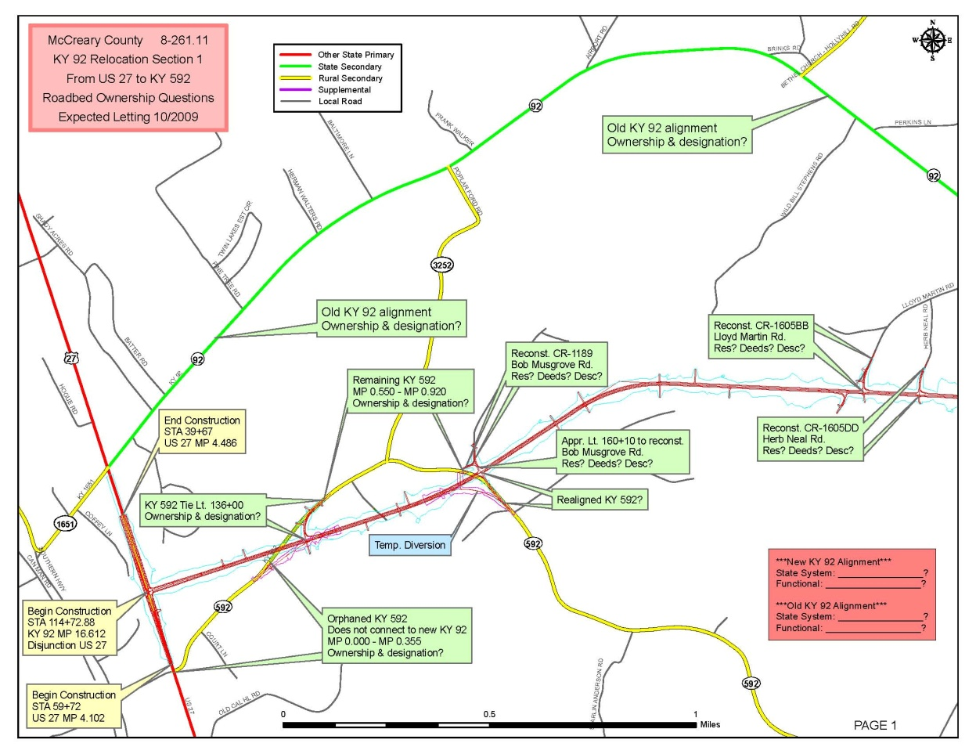
District Suggestions for Routing and Maintenance Funding
Should Old KY 92 classification be changed to a more appropriate funding source?
3 separated pieces of KY 592 & a connecting section of KY 3252 left -How should they be numbered?
Notes:
THIS LOOKS CONFUSING BECAUSE IT IS! ALL KINDS OF BITS AND PIECES TO DECIDE HOW THEY SHOULD FUNCTION WITHIN THE OVERALL NETWORK
Unless we get the documented classifications, we will stay confused and the revisions cannot be made in the GIS and HIS data.
So, look at each route involved with the project, even the old road which is outside the current project limits, and document how it will function within the network

Slide 36
Road Accepted into State-Maintained System
Systems Branch uses HIS lengths and data to develop Official Order
  Data Management Branch puts into HIS/GIS centerlines
  SPRS Official Order is the legal action to document acceptance into state-maintained system
R/W creates deed transferring bypassed roads or realigned entrances to local government (if possible)
Notes:
Later on, Transportation Systems and the District Planner may need to try to transfer other OLD DOGS to the local governments as well.

Slide 37
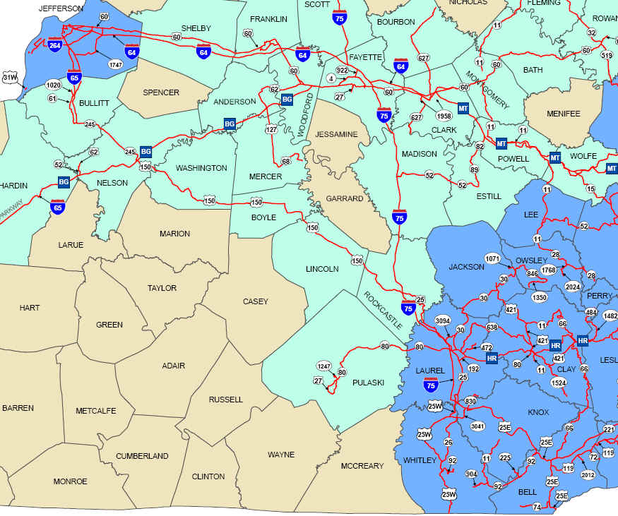
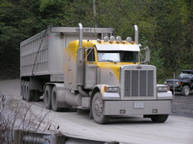
Coal Haul and Extended Weight Coal Haul
Routes classified in these networks:
  should be built to withstand heavy weights,
  will require additional maintenance funding,
  will affect traffic models & planning for future projects
1,500,000
ton-miles,
3700 road miles
Notes:
Not tracked in miles but in ton-miles (# tons hauled x miles on public roads)
Changes annually
Any other questions, see me later

Slide 38
Cartography Team Updates Maps
Once project open to traffic & in HIS, standard highway maps updated on internet
Official State Highway Map revised
If other systems change, those maps also updated: NN, NHS
Various maps as requested

Slide 39
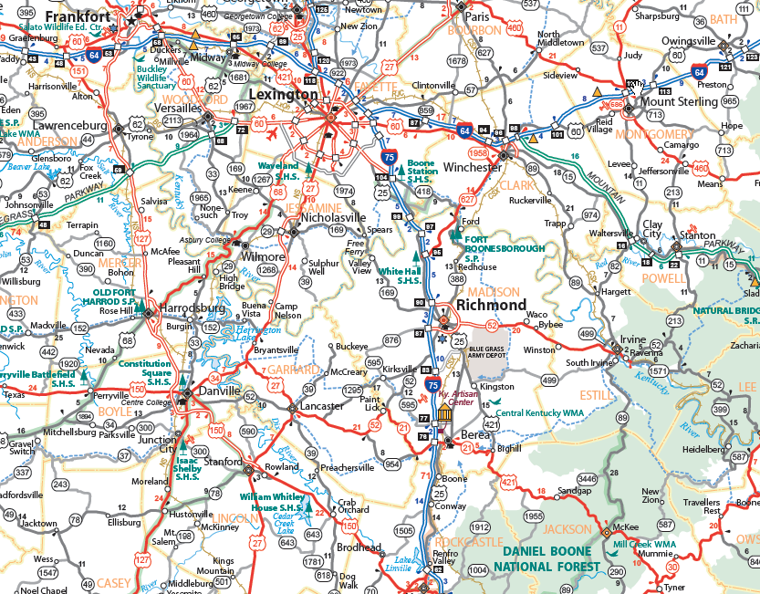
Kentucky Official State Highway Map
http://transportation.ky.gov/Planning/Pages/Official-Highway-Map.aspx

Slide 40
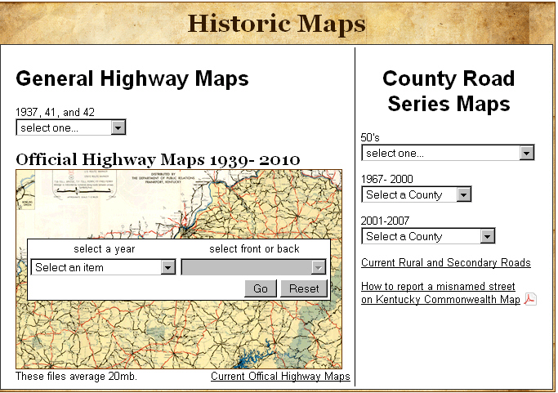
Historic Maps
http://transportation.ky.gov/Planning/Pages/Historical-Maps.aspx

Slide 41
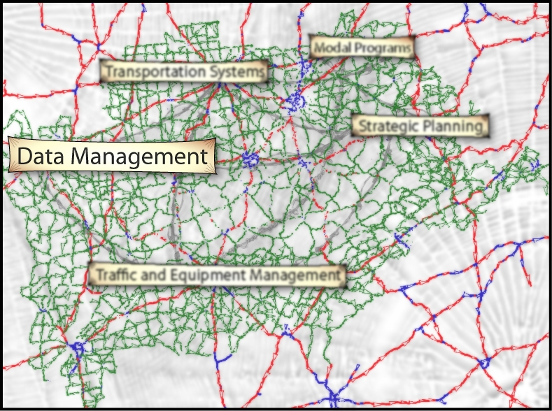
Data Management Branch

Slide 42

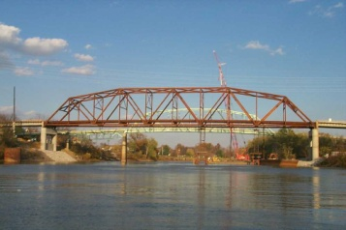
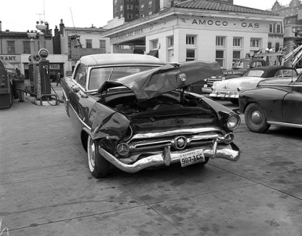
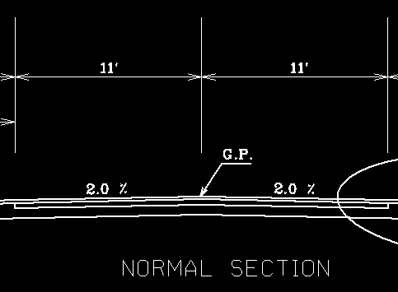
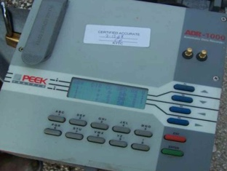
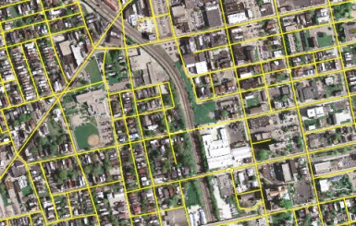
Highway Information System (HIS) Database
Spatial and Tabular
Tabular
Bridge Information
Pavement Information
Crash Information
Roadway Features
Highway
Information
System
Spatial
Traffic Counts
Roadway Centerlines

Slide 43
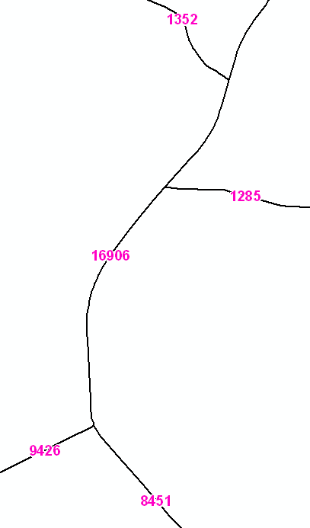
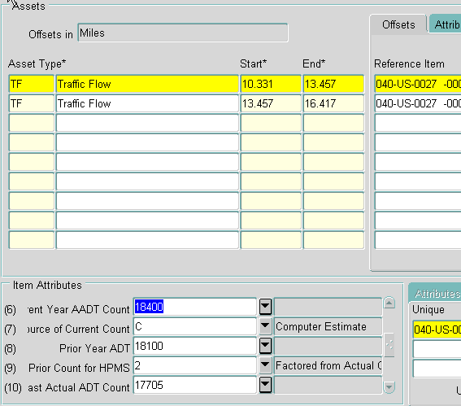
Highway Information System (HIS) Database
Spatial and Tabular – Traffic Counts
Tabular
Spatial

Slide 44
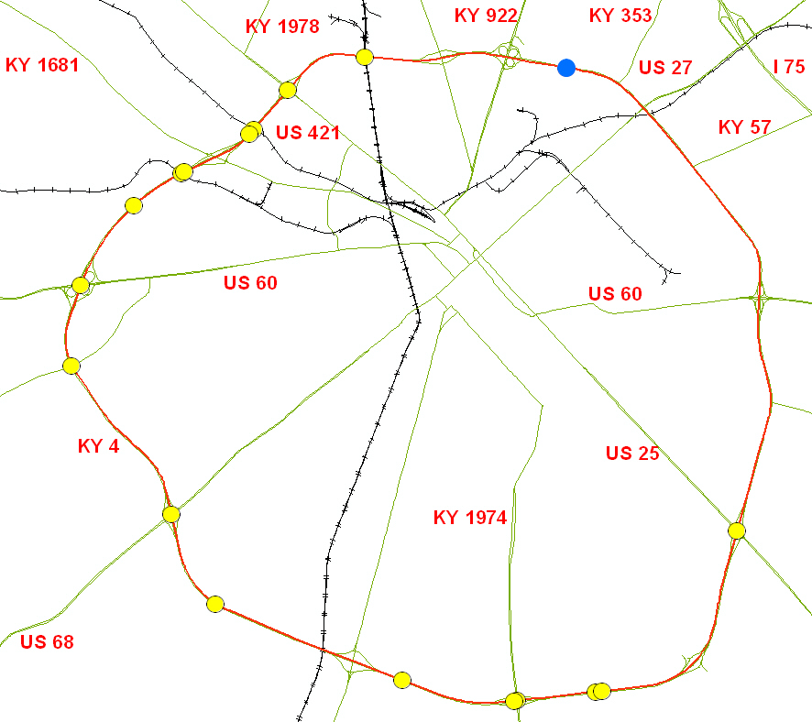
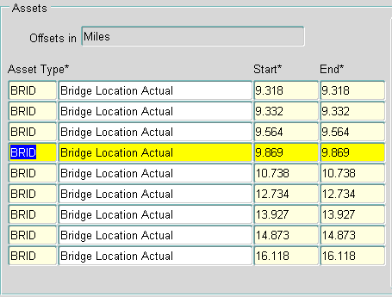
Highway Information System (HIS) Database
Spatial and Tabular – Bridges
Spatial
Tabular

Slide 45
Highway Information System (HIS) Database
How is data stored, loaded, and maintained?
  Data Storage
    County – Route – Mile Point
      Linear Referencing System (LRS)
  Data Loading
    County – Route – Mile Point
    Latitude/Longitude coordinates
  Data Maintenance
    HIS automatically and accurately updates the County – Route – Milepoint location of all data when roadway centerline changes are processed

Slide 46
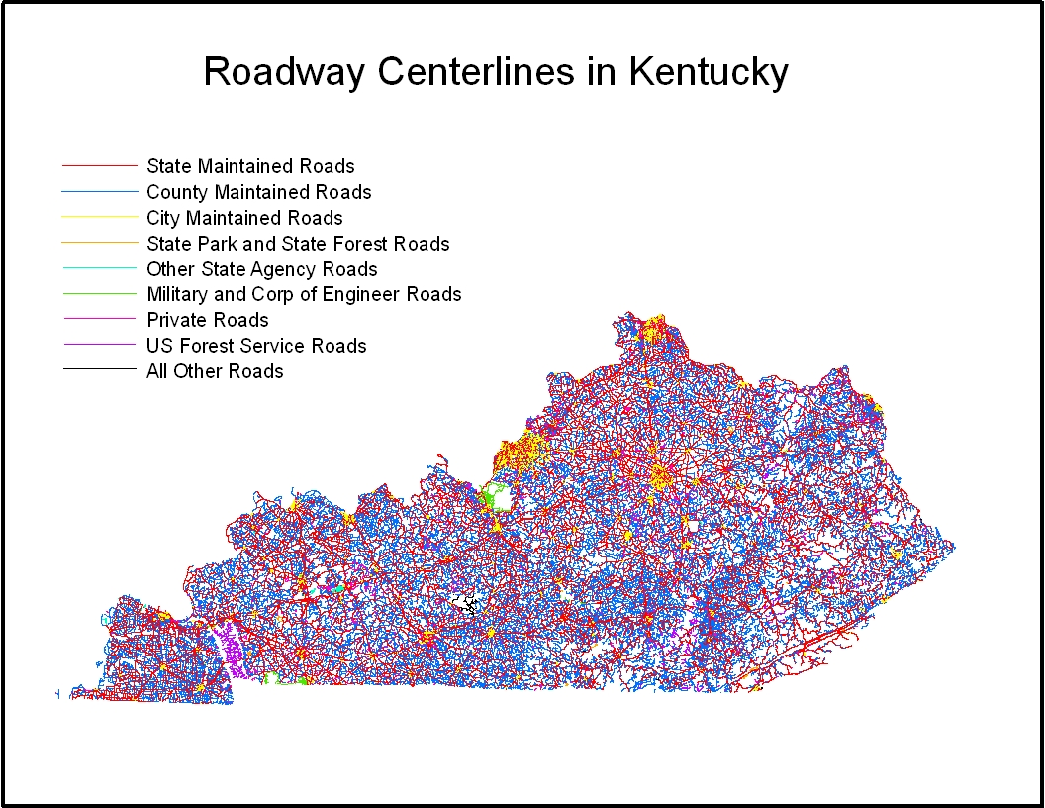
Highway Information System (HIS) Database
Roadway Centerlines

Slide 47
Highway Information System (HIS) Database
Roadway Centerlines
Electronic, GIS map of all public roads
  80,000+ miles of roadway centerlines
  KYTC, County, City, Other State Agency, Federal
  Electronic route network for Kentucky
  Stores official KYTC route designations and lengths
  LRS for KYTC County, Route, & Milepoint locations

Slide 48
Highway Information System (HIS) Database
Tabular Data
46 roadway data items
Highway Systems
  State Primary Road System
  Functional Classification
  National Highway System
Roadway Features
  Through Lanes
  Medians
  Shoulders
Roadway Information
  Speed Limit
  Truck Weight Classification
Traffic Counts
Crash Information
Bridge Locations
Pavement Information
What data do YOU have that needs County – Route – Milepoint locations?

Slide 49
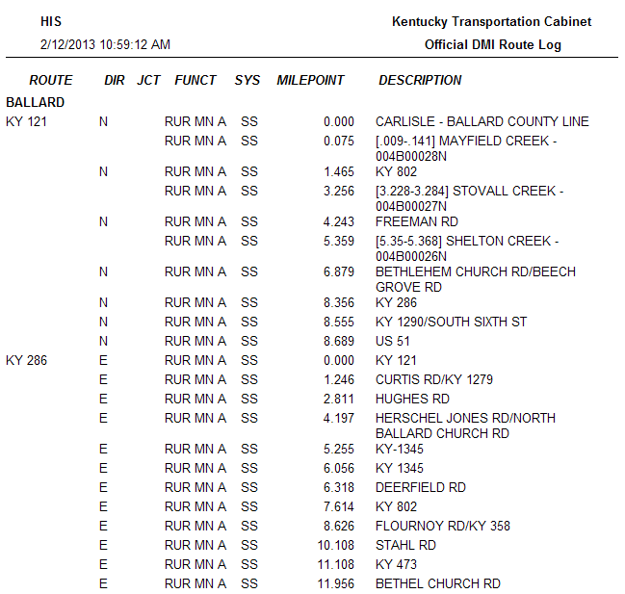
Highway Information System (HIS) Database
Tabular Data

Slide 50
The Need for Real Time Data
Why is it important?
  Data cannot be correctly analyzed or reported if the roadway centerlines are not updated timely to reflect the correct location
  What is impacted?
  Road Maintenance
    Snow and ice removal
    Mowing
    Other maintenance activities
  E-Mars route validation for project charges
  State Police E-911
  Roadway performance measures
  Locating bridges and crashes
  Many other reports and analyses (onto next slide…)

Slide 51

Highway Performance Monitoring System (HPMS)
Annual report submitted to FHWA
Reports the condition of Kentucky’s highway system
Significant portion generated from HIS data
Used by the Federal Government to help determine KYTC funding levels
Used by KYTC and partners to perform needs-based analysis on our roadways

Slide 52

Linking to Other Divisions’ Data
  HIS linkages to other Cabinet data systems
    OMS/PMS
    eMARS
    PONTIS

Slide 53
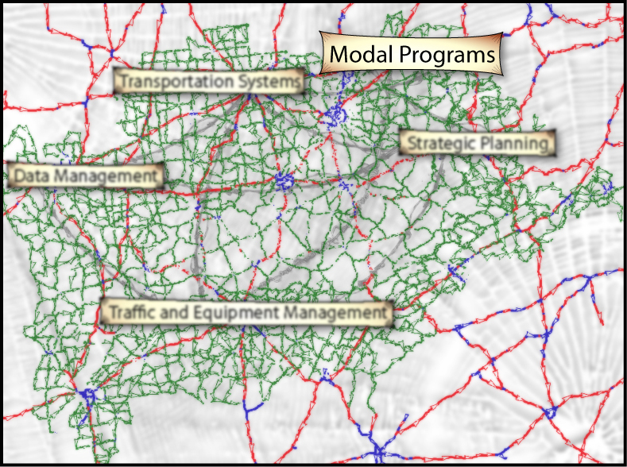
Modal Programs Branch

Slide 54
Multimodal Planning
Ferries
Bicycle & Pedestrian
Riverports
Railroads
Intermodal Connectors
Freight-Trucks
Coordinate with Other Areas
  Airports ~ Division of Aeronautics
  Transit ~ Office of Transportation Delivery
Notes:
What modes are missing from this list??
Elevators, people movers/escalators, and pipelines.

Slide 55


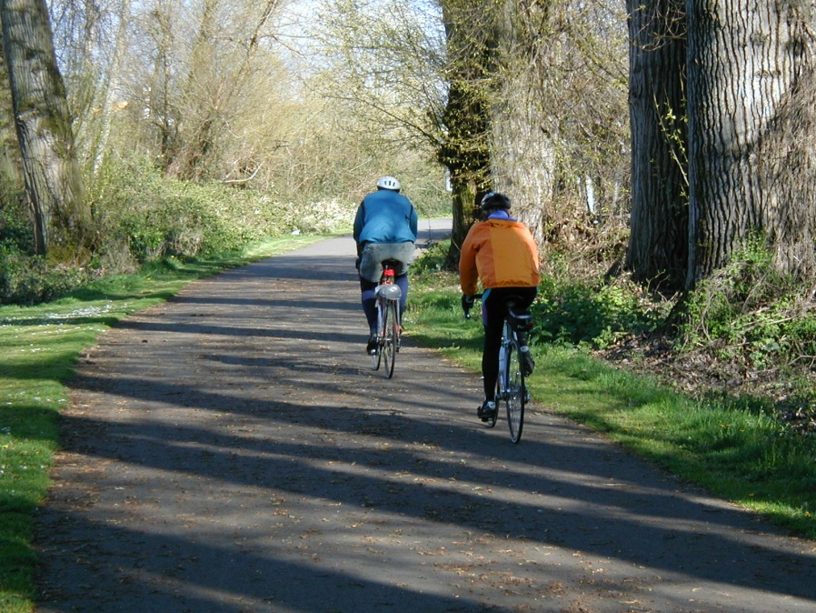
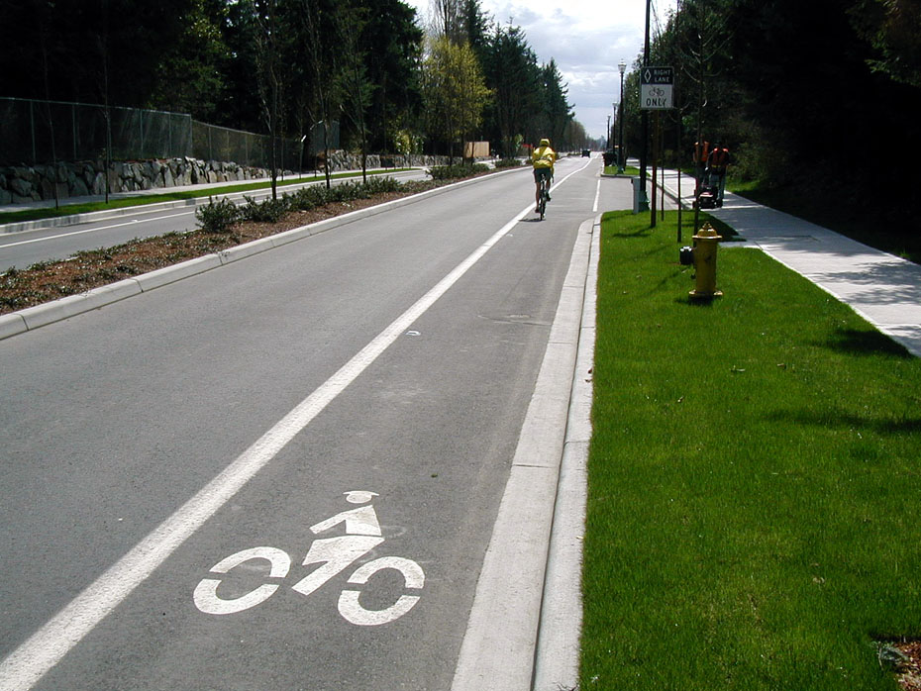


Pedestrian and Bicycle Program
Notes:
KYTC policy states that bicyclist and pedestrians shall be considered on every project: design, maintenance, and construction.
“Accommodations” does not always mean a sidewalk or bike lane. Sometimes it’s a wider shoulder, signage, or local education.
American with Disabilities Act coordination.
Safety for Peds-Louisville Pedestrian Fatality Focus Area by FHWA

Slide 56

Ferries
http://transportation.ky.gov/Ferries/Pages/default.aspx
Ferries- Kentucky has ten ferries or “moving bridges.”
Seven are subsidized with state dollars and two with federal for their operations

Slide 57

Riverports
Riverports
http://transportation.ky.gov/Riverports/Pages/default.aspx
-12 public riverports
-Ingress and egress to the ports
-Facilitate the intermodal with rail and truck
Changes in the past 2 years
KY Water Transportation Advisory Board
-Limited $$ for riverports.
Paducah Riverport-unloading coke
Notes:
Kentucky Water Transportation Board –2010 and Riverport Improvement Grant
KYTC Coordinates with Corp of Engineers and Coast Guard.
Corp of Engineers has annual federal budgets for navigation and flood control infrastructure. It’s hard for them to do long range plans when the $$ is not quantified from year to year.
Lock 52&53 near Paducah on the Ohio River is 20+ years past it’s design life. USACE has been building the new Olmsted lock and dam for 30+ years.
The Kentucky River is just for pleasure craft now. The remaining operable locks only work on the weekends from Memorial to Labor Day.

Slide 58

Railroads
Railroads
http://transportation.ky.gov/Railroads/Pages/default.aspx
  Movement of freight via rail
    Truck to Rail to Truck
    Barge to Rail to Truck
  At-grade rail crossings are handled by the Division of Right of Ways & Utilities.
  Tax incentives for Shortline RR
Changes in last 2 years
  Shortline Rail Fund as of 2010-2011
  2013 Rail Crossing Improvement Projects
Notes:
All the railroads in Kentucky are privately owned.
Both the track and the equipment are privately owned.
Even the places where the road meets the rail…KYTC has an easement or lease for the road, the rail R/W belongs to the private company.
Operation Lifesaver Visor Card/Bookmark handout

Slide 59

Railroads
Notes:
In addition to the freight railroads in KY we have 4 excursion rail lines and 4 Amtrak stops.
Amtrak runs on the freight rail lines. When passenger services is on the track, all freight must be on a siding, and vice-versa.
Passenger rail is supposed to have the right of way… anyone take Amtrak recently ??
New Rail mainline GIS available for state agencies (But not the public).

Slide 60

Fuel Efficiency
Notes:
1 15-barge Tow = over 200 train-cars = nearly 1,000 trucks
1 15-barge Tow = 3-5 personnel
99% of all first and last mile freight trips are by Truck

Slide 61

Compare…

Slide 62





Freight
Freight
http://transportation.ky.gov/Planning/Pages/Freight-Planning.aspx
How do goods move in, out, and through our state??
What are the effects of congestion on these moving warehouses??
Notes:
Nationally, 7% Water
<1% Air
15% Rail
78% Road
Logistics—Big Business

Slide 63
Commodities in KY by Million Ton
http://ops.fhwa.dot.gov/freight/freight_analysis/faf/index.htm
Notes:
Million Tons
Coal/Pet Prod 159.8
Coal 118.5
Gravel 63.1
Gasoline 17.5
Waste/scrap 16
Basic chemicals 9.9
Nonmetal min. prods 2 7.9

Slide 64
Commodities in KY by $ Million
http://ops.fhwa.dot.gov/freight/freight_analysis/faf/index.htm
Notes:
$ Millions
Machinery 60,483
Vehicles/Parts 45,449
Coal/Pet Prod 43,548
Electronics 20,011
Mixed freight 17,507
Textiles/leather 9,050

Slide 65

Congestion Management
Techniques to improve traffic flow:
  Mobility Analysis, Ramp Metering, Travel Time, Access Management, Smart Growth, Roundabouts, and Congestion Management.
These can be a paradigm shift for a community or a small tweak in the signal system
Move people and goods more efficiently
MAP-21
  Performance Measures
  Travel Time and Delay
    Personal
    Commercial
Notes:
This process is usually multi-divisional teams: Traffic, Maintenance, Design, Planning, MPO, HDO, Emergency Response and others.

Slide 66

Air Quality ~ Ozone - Smog
Projects must be analyzed to see how they affect regional air quality.
All projects/change must be evaluated BEFORE federal funds can be used.
Notes:
Northern KY (Boone, Kenton, Campbell)
Louisville (Jefferson, Bullitt, Oldham)
Ashland (Boyd)
Clarksville/Oak Grove/Fort Campbell (Christian)
New Ozone standard in fall/winter of 2010 which will increase the number of impacted counties significantly!!!

Slide 67
Air Quality
Five Transportation Pollutants
  O3 ~ Ground Level Ozone
    NOX
    VOC or HC
  Particulate Matter
    PM2.5
    PM 10
  CO ~ Carbon Monoxide
  SO2 ~ Sulfur Dioxide
  Pb ~ Lead
Notes:
CO, SO2 and Pb are in attainment in KY. No test are required except for CO on very large projects such as urban interstates.
You may be thinking… What about Green House Gases….
There are no designated pollutants for GHG to date…although there are thousands of culprits. EPA has not defined which ones they will control.

Slide 68

Air Quality – PM2.5 Fine Particulate
Notes:
You see the soot that comes out of smoke stacks and the exhaust from tailpipes… these smokey hazes are made up of PM2.5
All of the pollutants listed are Health Bases standards.
Some may have secondary standards for agriculture and property benefits.
2.5 PM is small enough to get VERY deep into the lungs

Slide 69
Traffic Forecasting
http://transportation.ky.gov/Planning/Pages/Traffic-Forecasting.aspx
Use the collected data, trend analysis, and computer models to predict present and future traffic.
Data includes traffic counts, land use, width of lane, number of lanes, speed limit, driving speed, population, employment, and number of housing units ….
Forecasting Reports include:
  ADT
  DHV
  AM / PM Peak
  Truck %
  ESAL
  Turning Movement Analysis.
Notes:
Ron’s system maps and functional class data
Josh’s HIS data for width and number of lanes and spatial placement
Jadie’s Traffic counts—Vehicle classification counts.. And special counts and turning movement counts.

Slide 70

Traffic Modeling
How much traffic is on a road today and in the future?
What happens if we add a bypass or close a road??
Notes:
Models are tools that can help us find solutions…yes… Practical Solutions
Large scale models like the statewide model (seen here) can answer regional and multi-county corridor queries.
Micro or Simulation models can be used to analyze intersection improvements.
Examples
New Developments
New Bypass Roads
Travel estimates for entire regions

Slide 71


Traffic Modeling

Slide 72
KYTC Division of Planning

Slide 73
Study Tasks
Examine existing conditions - Data
Define Purpose and Need
Identify project termini
Identify known environmental concerns
Involve public officials, government agencies, other stakeholders, and the public

